Slide 1

Mini project
Machine Learning
Eloisa
Diogo
Lokesh

Slide 2
Project Overview
Project Objective:
This project strengthens Machine Learning analytical thinking and Python data analysis skills.
Project Description:
Explore a one-year dataset of King County house sales (May 2014–May 2015) to analyze pricing trends through data loading, visualization, and models analysis, been price the target feature.

Slide 3
Work Flow
Work flow of Machine Learning Model
Model Training With Raw Data Path
Model Training With Filtered Data Path
Linear Regression
Polynomial Regression
Random Forest
Xg Boost
EDA
Data Cleaning
Feature Engineering
Data Scaling
Data Encoding
Model Training and Evaluation

Slide 4

Implementation Details
EDA
As part of our analysis, we began with an Exploratory Data Analysis (EDA) to better understand the dataset before building any predictive models.
We made sure the dataset was clean and consistent.
To gain deeper insights, we visualized relationships between variables to identify features most related to house prices. This step was key in shaping our approach for the modeling phase.
Reviewed the Data Frame structure, removed duplicate entries, and validated data types as part of core exploratory data analysis activities.

Slide 5
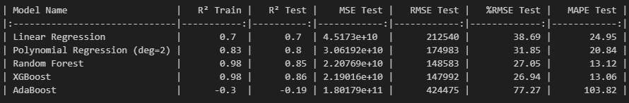
Model Comparison (On Raw Data)
- XGBoost and Random Forest gave the best results (highest R², lowest errors).
- Polynomial regression improved over linear, but less than tree-based models.
- AdaBoost performed poorly and is not suitable on this dataset.

Slide 6
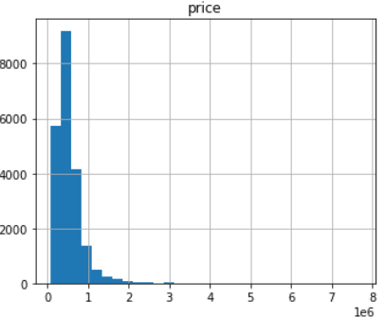
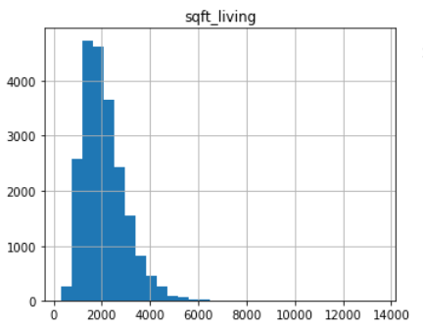
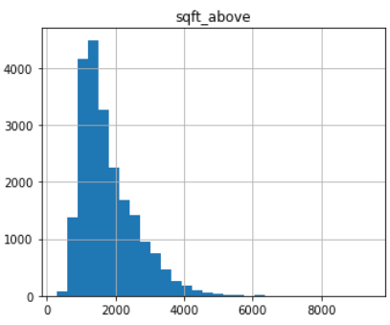
Implementation Details
Univariate Analysis
Histograms Plots
Price, the target feature, shows a
positively skewed distribution.
sqft_living and sqft_above present
a potential collinearity, both presented
Positively skewed distribution.
For other features, it was not possible to observe a clear distribution; further analysis is required.

Slide 7
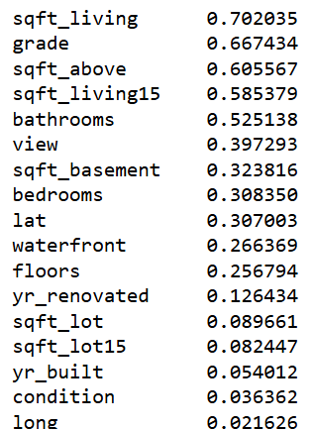
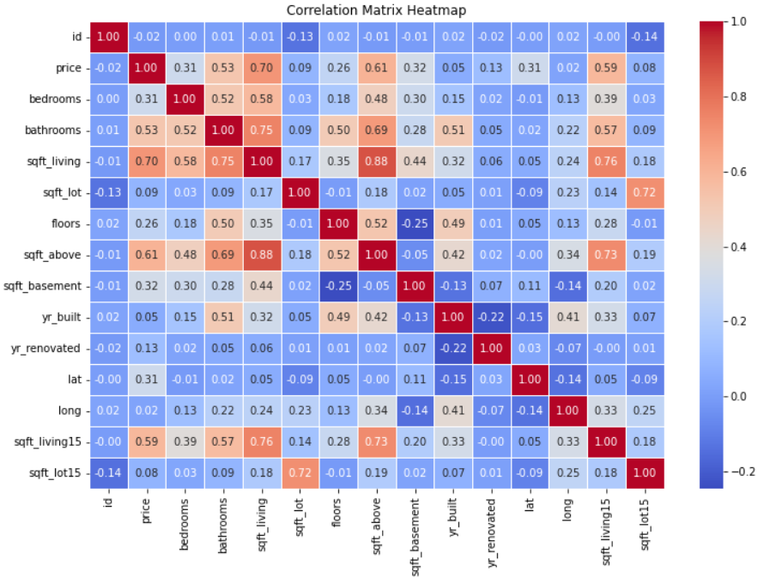
Correlation Analysis
Bivariate Analysis
Clear collinearity between sqft_above and sqft_living.

Slide 8
Feature Engineering
Dropped Columns:
ID and Date: Removed because they do not help predict price.
yr_built and yr_renovated: Dropped after extracting more meaningful features.
Created New Features:
Age: Computed from the year the house was built. Shows how old each house is.
Renovated: Binary feature (1 if renovated, 0 otherwise), based on renovation year.
Purpose:
Streamlined dataset by removing redundant and non-informative columns.
Enhanced model interpretability and predictive power using clearer, relevant features.

Slide 9
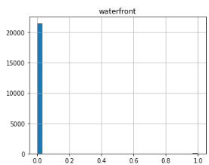
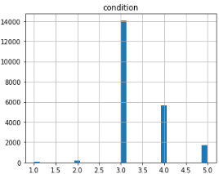
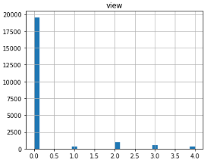
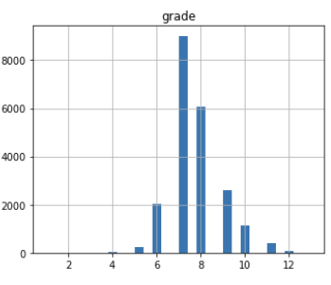
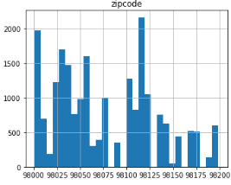
Categories considered for Model Training
Univariate Analysis
Histograms Plots
Features were classified as categorical based on their distinct, qualitative values, enabling appropriate data preprocessing in the analysis workflow.

Slide 10
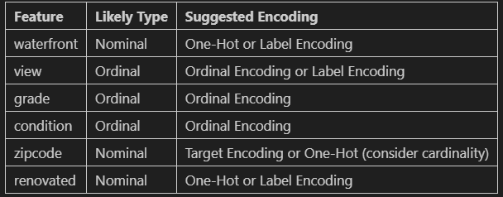
Data Cleaning
Data Encoding
Data Scaling
Dropped Outliers, Removed Duplicate ID

Slide 11
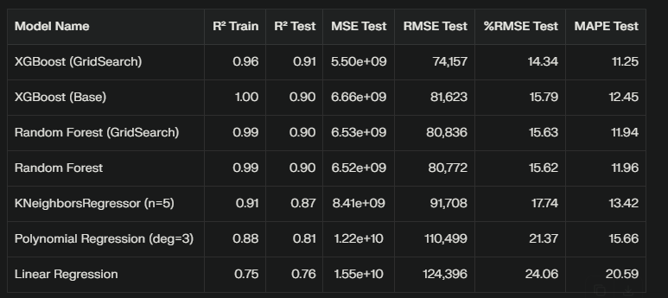
Model Performance
For the given regression task, XGBoost tuned with GridSearch should be preferred as the best model, closely followed by Random Forest.​
Simpler models like Linear Regression may be easier to explain but are less performant on complex data.

Slide 12
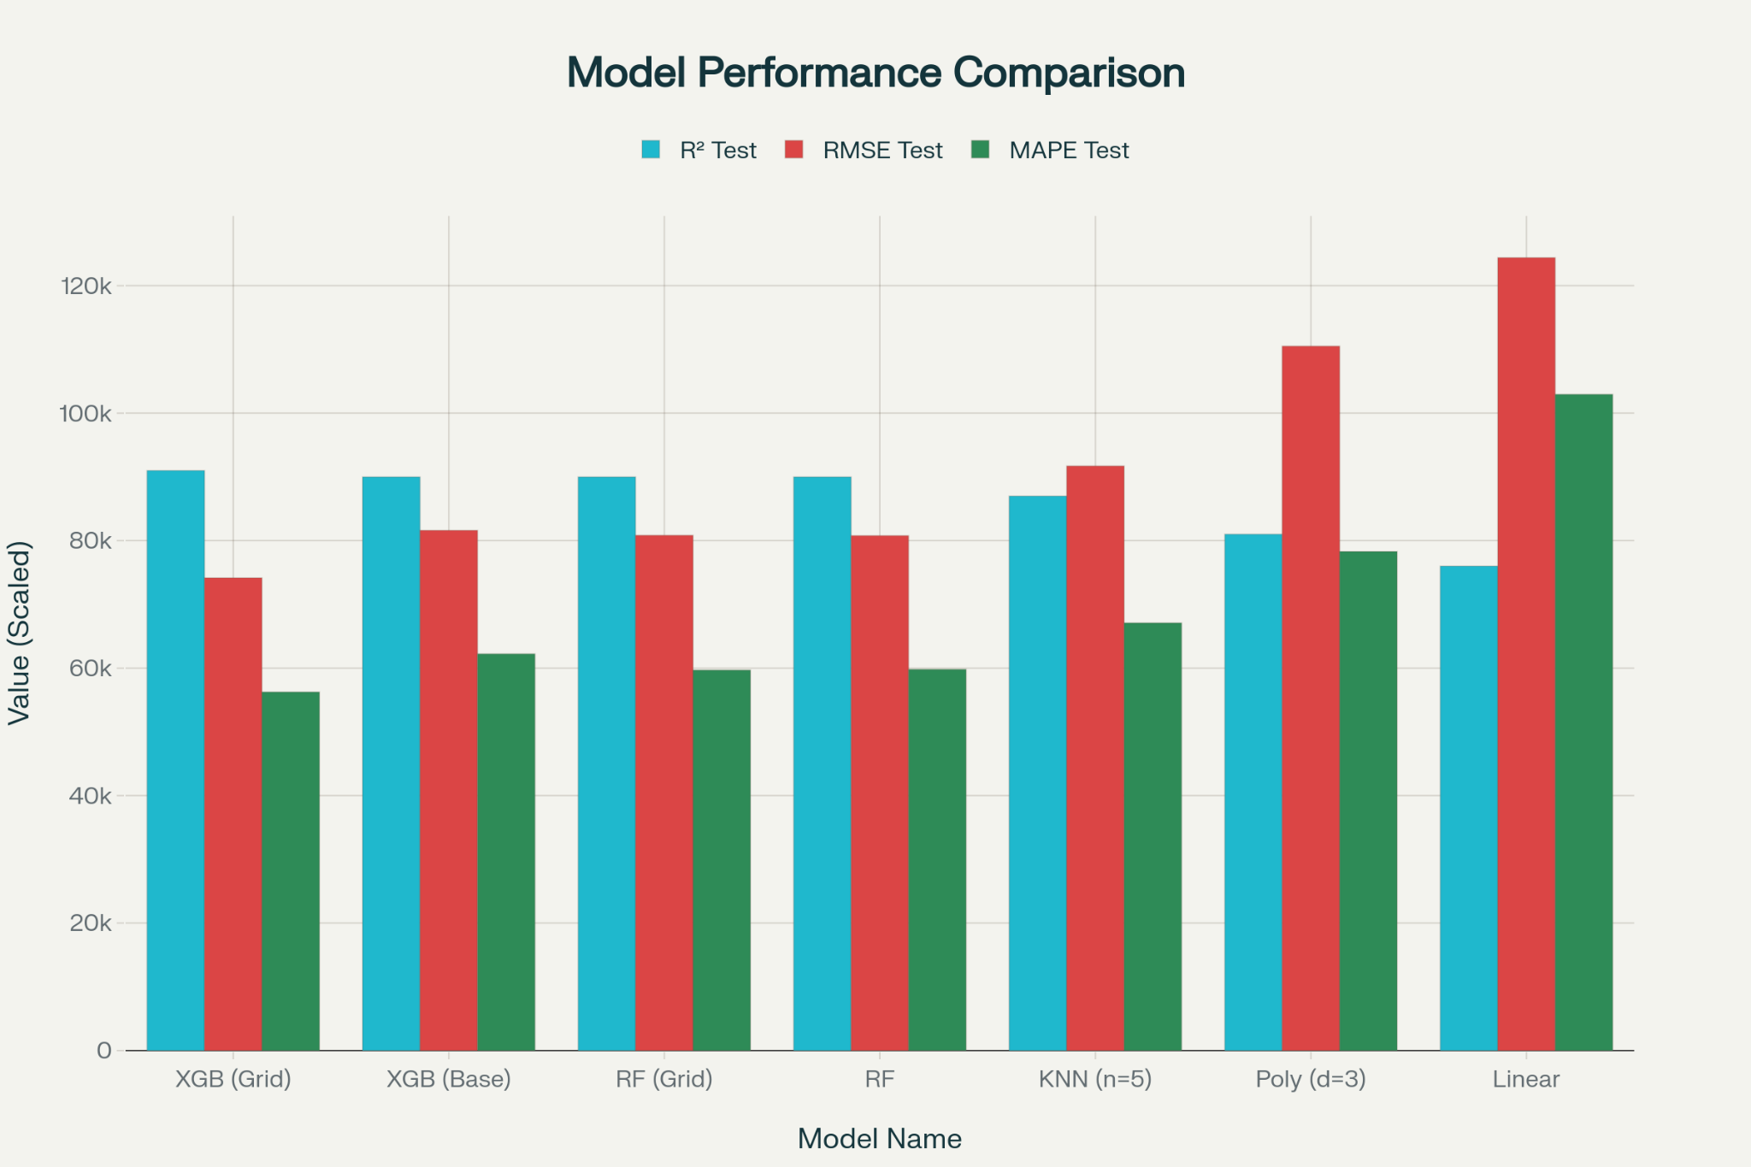
Model Performance

Slide 13
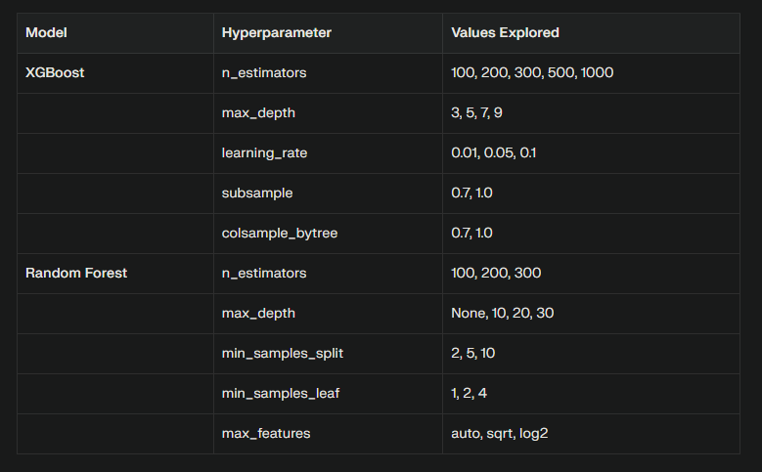
HyperParameter Tuning with GridSearch

Slide 14
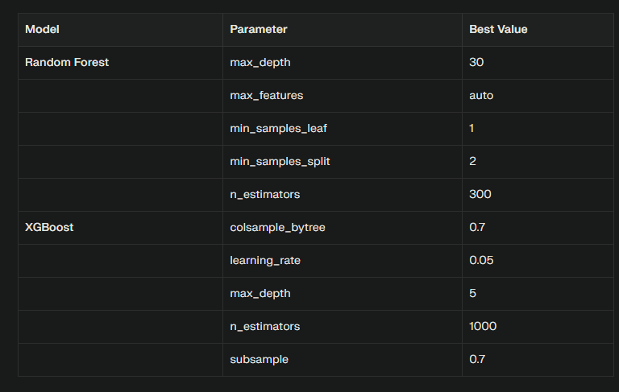
Best Parameters Tuning with GridSearch

Slide 15
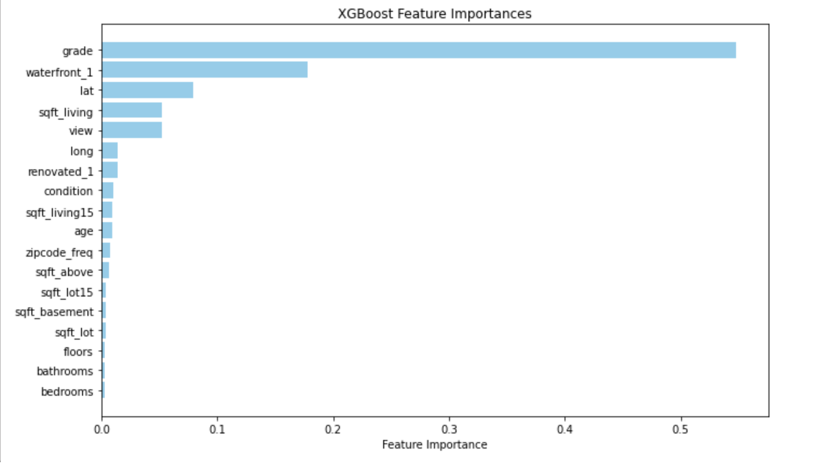
Feature Importance
These is the list of features that we included in our models, here we are able to see which ponderation have each feature: grade, lat and sqft_living are the more significant ones.

Slide 16

Teamwork & Project Management
We thoroughly reviewed the data and conducted group discussions to share new findings and relevant insights for the next steps. We clarified questions with the coordinators and consolidated our conclusions to summarize them in the final presentation.

Slide 17
Key Learnings & Takeaways
Data preprocessing is crucial. Cleaning and encoding decisions directly influence predictive stability.
Non-linear models outperform linear ones in complex, datasets like housing markets.
Evaluation across multiple metrics (R², RMSE, MAPE) gives a fuller picture of model reliability.

Slide 18
Major Obstacle
Handling highly skewed distributions (e.g. price, lot size) without discarding real luxury homes.
Managing geographical variance — same sqft may mean very different prices across ZIP codes.
Preventing overfitting in high-capacity models (solved via tuning).
Ensuring scalability and interpretability for future deployment

Slide 19
Conclusion and Insights
This project aimed to predict house sale prices using various features from the King County dataset, such as number of bedrooms/bathrooms, total living area, lot size, location, and more.
We compared multiple models - from simple Linear Regression to advanced ensemble methods like Random Forest, AdaBoost, and XGBoost - both before and after data cleaning and feature processing.
The main goal was to evaluate how data quality and modeling techniques influence predictive performance.
After thorough experimentation and refinement:
XGBoost emerged as the most reliable and accurate model, achieving strong generalization (R² ≈ 0.96) and robust performance across all validation metrics.
The study demonstrates that:
Clean, engineered data (like features engineering + ensemble methods) = superior predictive accuracy
sqft_living, grade,waterfront, view, and location are the key value drivers in King County’s housing market.

Slide 20
Prediction? 100% chance we’re done
# The End()
We faced real-world challenges with skewed data and location variance, solved them through cleaning and feature design, and proved that XGBoost, combined with high-quality data, delivers accurate, explainable, and business-ready house price predictions

